Slide 1
The Perimeter Is Dead
Long live the perimeters...
Pawan Shankar, Product Manager Dome9 Security

Slide 2
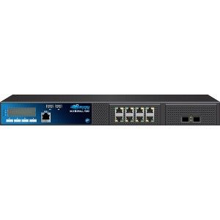
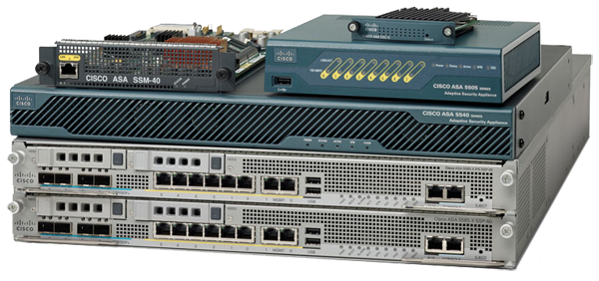
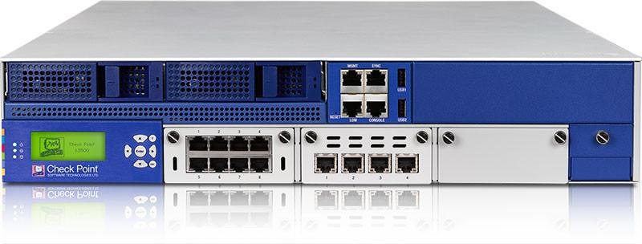
Back in the good ol’ days...
Enterprise IT systems are deployed on-prem
Network security devices are deployed as gateway devices

Slide 3



Hard Shell, Soft Inside
Hard Shell - All traffic is tunneled through these choke points
Soft Inside - very basic segmentation (usually 3 zones)
https://commons.wikimedia.org/wiki/File:Huevo_Quebrado.jpg

Slide 4
And then came the public cloud...
Nowhere to deploy my big box. Now we got ‘virtualized appliances’
Where would I deploy my virtualized appliance ? I have dozens of VPCs
Auto-Scaling :(
ELB and other platform services awareness :(

Slide 5
Solution - Use Cloud-Native Network Security
SecurityGroups and NACLs
Nothing to deploy, zero cost - comes with the platform
Easy micro-segmentation for east-west traffic
Out of the box auto-scaling
Ingress/ egress / logging - all included

Slide 6
Yay. Are we done?

Slide 7
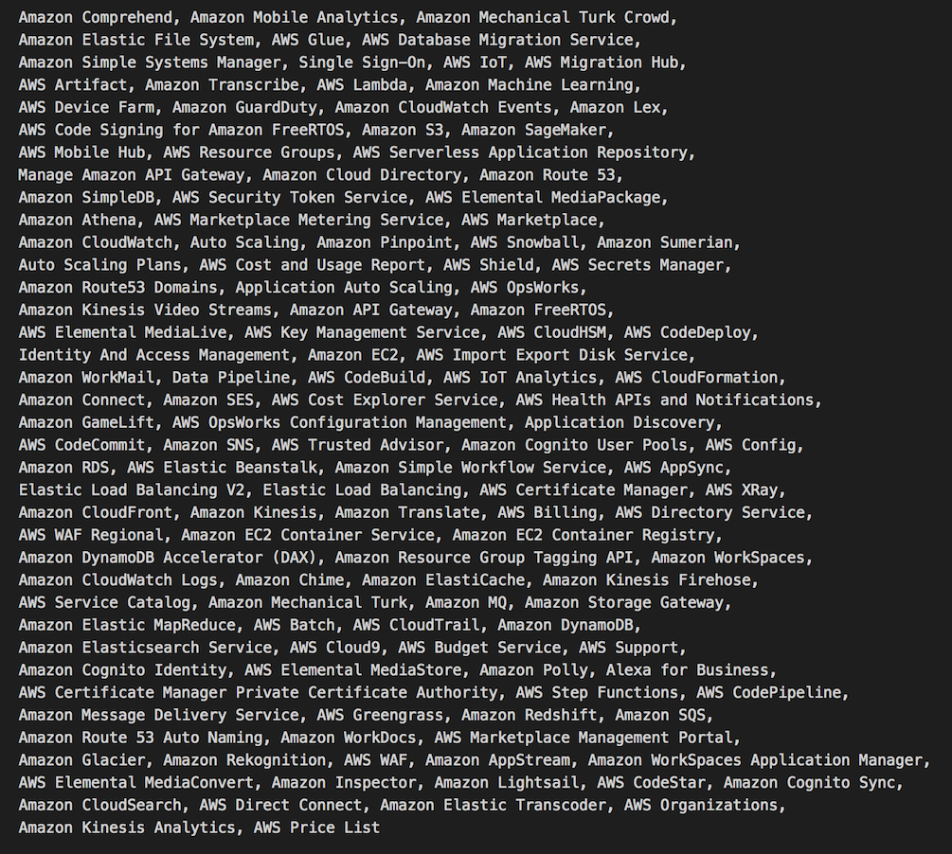
Evolving perimeter concept in the cloud
The public cloud is a different beast:
Public by nature: services and control plane
137 different AWS Services*
Plethora of managed platform services
What does it mean?

Slide 8
The network perimeter is now just one out of many

Slide 9
The new cloud perimeters
These new perimeters cannot be protected by a network firewall:
Data Perimeters
Allowing unauthorized users to read / modify or delete your private data
Compute Perimeters
Allowing external entities to run code in your environment
Messaging Perimeters
Allowing external entities to receive / send messages to private systems
Identity Perimeter
Allowing external entities full control over your virtualized data center

Slide 10
Data Perimeters
Allowing unauthorized users to read / modify or delete your private data

Slide 11
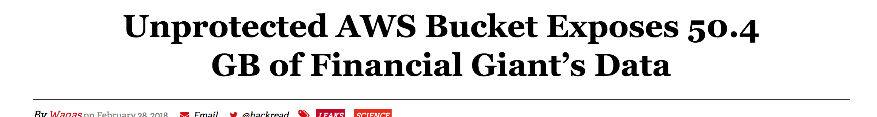
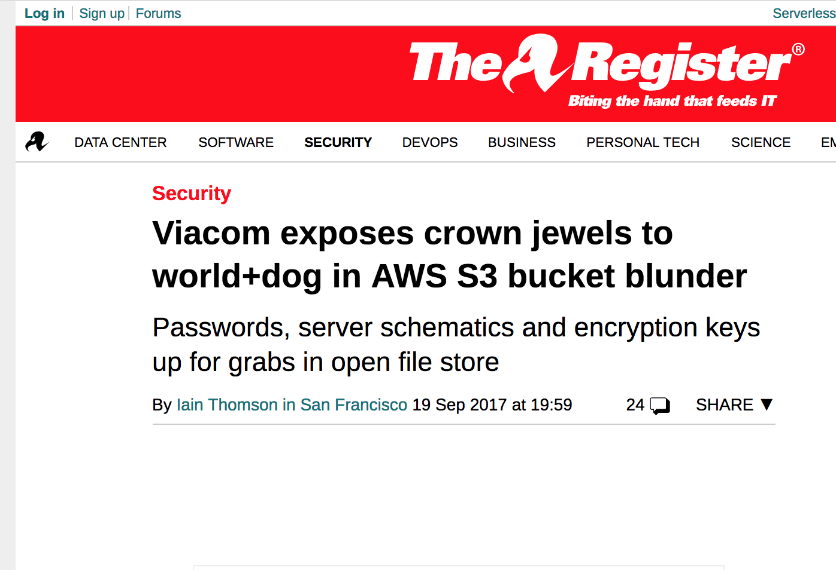
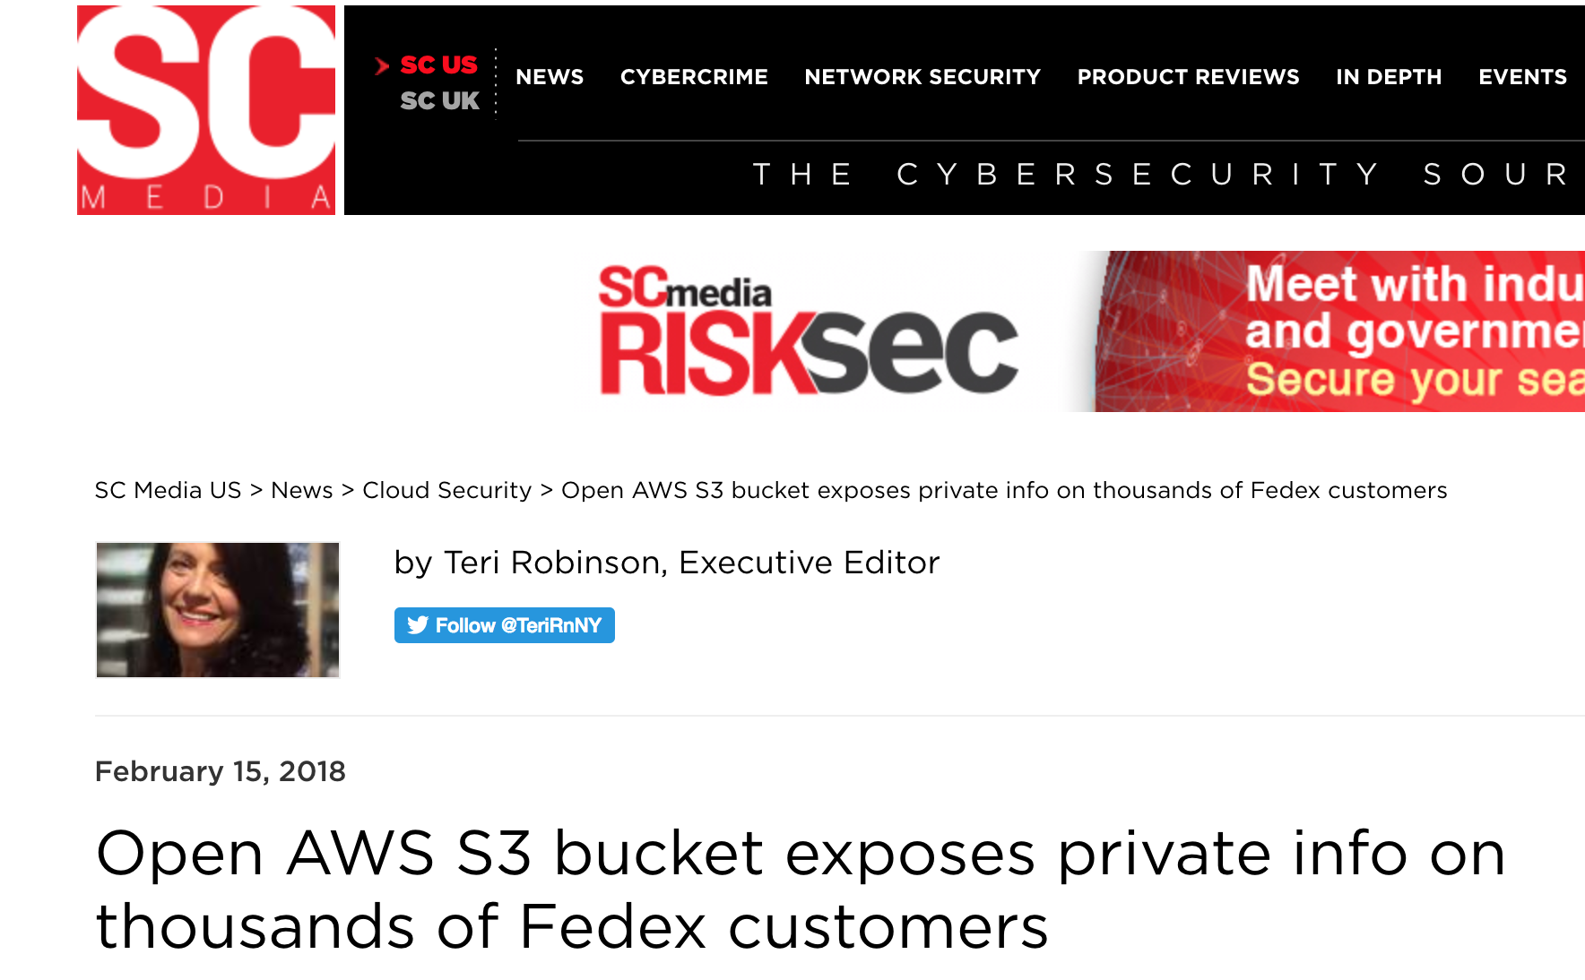
S3 Perimeter
S3 - AWS public object storage service
Authorization is governed by bucket and object policies as well as IAM policies
Misconfigured bucket or object can expose the data to be read/ manipulated by non authorized entities

Slide 12
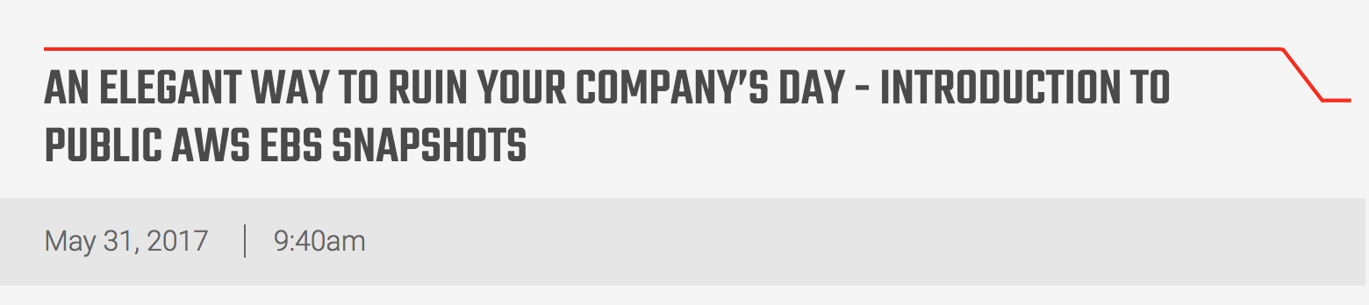
EBS Snapshots Perimeter
EBS - Elastic Block Storage (virtual hard disks) allows to create backup snapshots.
These snapshots can be made public. Sometimes misused by people in order to share data
Right now, there are many public EBS volumes out there that contain private data such as SSH credentials, PII info etc...
https://www.nvteh.com/news/problems-with-public-ebs-snapshots

Slide 13
AMI Perimeter
AMI - Amazon Machine Image is a full virtual machine image
AMI can be shared with specific accounts but can also be a public image
A virtual machine image can possibly leak your code, intellectual properties, SSH and DB credentials, etc...
Danger point: when the DevOps Image-baking-env is deployed on a different account from the production env
Additional read: https://docs.aws.amazon.com/AWSEC2/latest/UserGuide/sharingamis-explicit.html

Slide 14
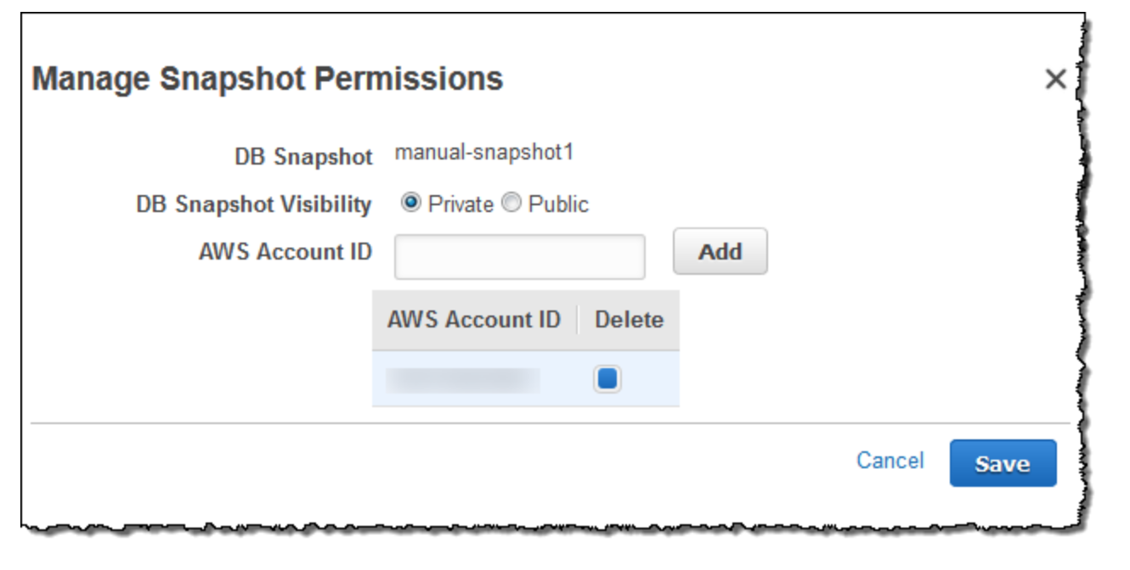
RDS Snapshots Perimeter
RDS - AWS Relational DB Service is a managed relational DB service (supporting MySQL, Postgres, MS SQL).
RDS, similarly to EBS provides snapshot capability. These snapshots can be made public, potentially exposing private customer data
https://docs.aws.amazon.com/AmazonRDS/latest/UserGuide/USER_ShareSnapshot.html

Slide 15
CloudWatch Logs Perimeter
CWL - a managed logs aggregation service by AWS
Logs can contain private data*
CWL has the concept of ‘cross account subscription’ that allows other AWS accounts to read log data. While this cannot leak data to the entire internet it is a valid perimeter that can leak data to 3rd parties, partners, etc...

Slide 16
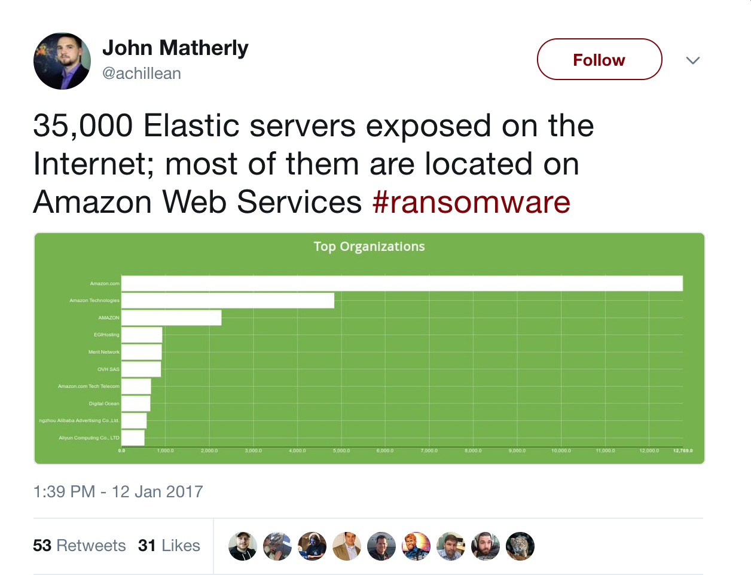
(Hosted) ElasticSearch Perimeter
AWS Managed ElasticSearch service (log aggregation / search engine)
Until recently the only deployment option was outside the VPC - in an internet accessible AWS managed network. (now there is a VPC option)
In addition, the configuration of the public endpoint’s IP address filtering is done via resource policy…
Possible damage: private data leak, manipulation, deletion
Learn more: https://docs.aws.amazon.com/elasticsearch-service/latest/developerguide/es-vpc.html

Slide 17
KMS
AWS KMS is a fully managed (encryption) Key Management Service
Every key can have a ‘Key Policy’ that controls its access
Misconfigured KMS policy means that 3rd party can have read/delete access to your encryption keys which:
In combination with a data leak can read your private encrypted data
In case of deletion - render your private encrypted data inaccessible

Slide 18
Compute Perimeters
Allowing external entities to run code in your environment

Slide 19
Lambda Perimeter
Lambda - AWS new(ish) serverless computing platform
Lambda can be run inside your VPC accessing private data and resources
Lambda can be invoked through events subscriptions or manually
Lambda can have a resource policy that allows invocation by non-authenticated users / external AWS accounts.
This policy is not displayed in the UI console

Slide 20
API Gateway Perimeter
Amazon API Gateway is a fully managed API front-end service
API Gateway exposes an always-on internet facing API front-end that can then call Lambda functions and EC2 instances inside the VPC.
While the API GW->EC2 instance is governed by the netsec infra* (hence part of our Network Perimeter), the API GW->Lambda path is not governed by any networking control point
A misconfigured API gateway can mean that unauthorized users could access (invoke) lambda functions or access internal VPC compute resources

Slide 21
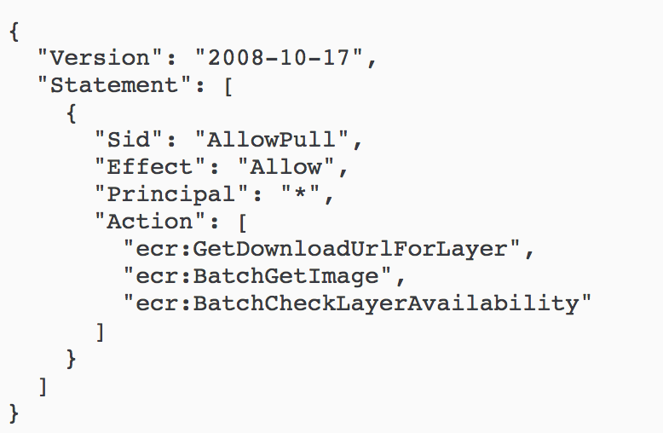
ECR Perimeter
Amazon Elastic Container Registry (ECR) is a fully-managed Docker container registry service.
ECR can have resource policies that allow unauthorized users to access, push, pull docker images.
Misconfiguration can mean a code or IP leak or even allow 3rd parties to run (privileged) rouge code in the users’ environments.
Learn more:
https://docs.aws.amazon.com/AmazonECR/latest/userguide/RepositoryPolicies.html

Slide 22
Messaging Perimeters
Allowing external entities to receive / send messages to private systems

Slide 23
SNS, SQS, Kinesis Perimeters
3 different messaging services provided by AWS
All these services expose resource based policies that can allow 3rd parties to send/ receive / delete messages
A misconfigured service could allow any unauthorized entity to access/modify private system messages

Slide 24
Cloud Control Plane Perimeter
Allowing external entities control over your virtualized data center...

Slide 25
Identity Perimeter
The public cloud brings an always-on, internet accessible web console and management APIs.
As the console is always accessible, any 3rd party access to a privileged IAM User / IAM Role means a full access to any cloud resource : instances, DB, DNS etc…
IAM Users - via compromised credentials, API keys …
IAM Roles - accessible to 3rd parties via cross account roles and compromised machines/ applications

Slide 26
Recap
The new perimeters that cannot be protected by a network firewall
Data Perimeters
Allowing unauthorized users to read / modify / delete private data
S3, EBS Snapshots, AMI, RDS Snapshots, CloudWatchLogs, ElasticSearch, KMS
Compute Perimeters
Allowing external entities to execute code in your environment
Lambda, API Gateway, ECR
Messaging Perimeters
Allowing external entities to send / receive messages to private systems
SNS, SQS, Kinesis
Identity Perimeter
Allowing external entities full control over your virtualized data center
Cloud console & open management API endpoints, IAM user & IAM roles

Slide 27





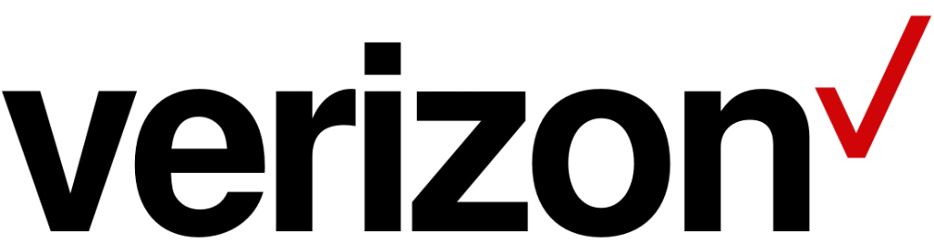








Shameless plug - Dome9 Security
SaaS platform for security and compliance automation
Born-to-the-cloud security company providing:
Visibility into cloud assets, networks and configurations’ security posture
Establishing consistent security across multiple accounts and regions
Baselining and continuous enforcement of security best practices and compliance
Prevention of security configuration drift
HQ in Mountain View, R&D in Tel Aviv; we’re hiring!

Slide 28

Thank you
To learn more:
Tweet Dome9 : @Dome9
Visit Dome9 website: dome9.com
Dome9 blog: dome9.com/blog
Sales Inquiries? Contact Beverly Peluso: Beverly@Dome9.com

